Slide 1

Substitution Method for Logarithmic Recurrence Analysis
CSA0620 – Design and Analysis of Algorithm
Presented By:-
Sameer Ahmed G - 192421154
Guided By:
Dr. A Sairam

Slide 2
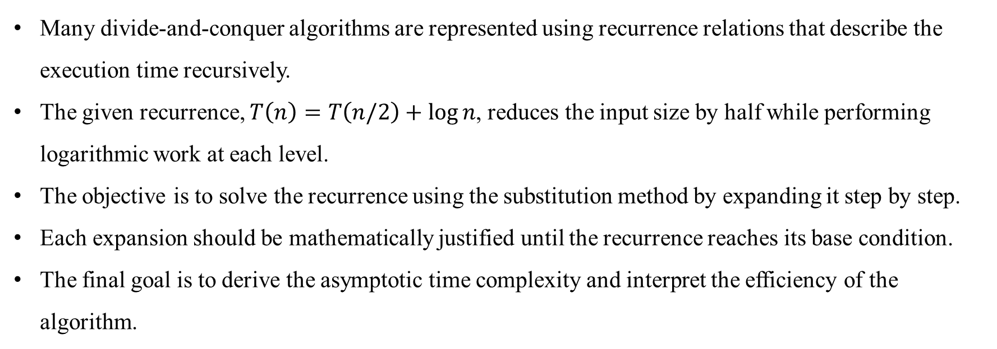
PROBLEM STATEMENT
Many divide-and-conquer algorithms are represented using recurrence relations that describe the execution time recursively.
The given recurrence, $T\left(n\right)=T\left(n/2\right)+\log{n}$, reduces the input size by half while performing logarithmic work at each level.
The objective is to solve the recurrence using the substitution method by expanding it step by step.
Each expansion should be mathematically justified until the recurrence reaches its base condition.
The final goal is to derive the asymptotic time complexity and interpret the efficiency of the algorithm.

Slide 3
ALGORITHM OVERVIEW
The substitution method solves a recurrence by repeatedly replacing the recursive term with its expanded form.
Every recursive call reduces the problem size from n to n/2, creating a sequence of smaller subproblems.
At each recursive level, an additional computational cost of log n is incurred.
The recursive expansion continues until the input size becomes one, which serves as the base case.
The accumulated cost of all recursive levels is simplified using summation formulas to determine the overall complexity.

Slide 4
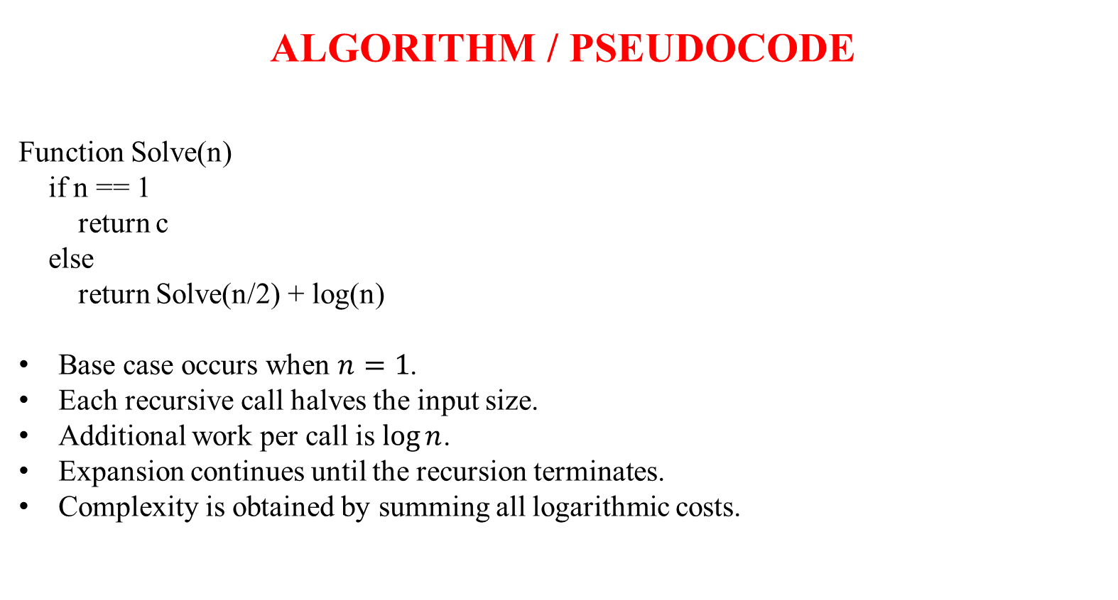
ALGORITHM / PSEUDOCODE
Function Solve(n)
if n == 1
return c
else
return Solve(n/2) + log(n)
Base case occurs when $n=1$.
Each recursive call halves the input size.
Additional work per call is $\log{n}$.
Expansion continues until the recursion terminates.
Complexity is obtained by summing all logarithmic costs.

Slide 5
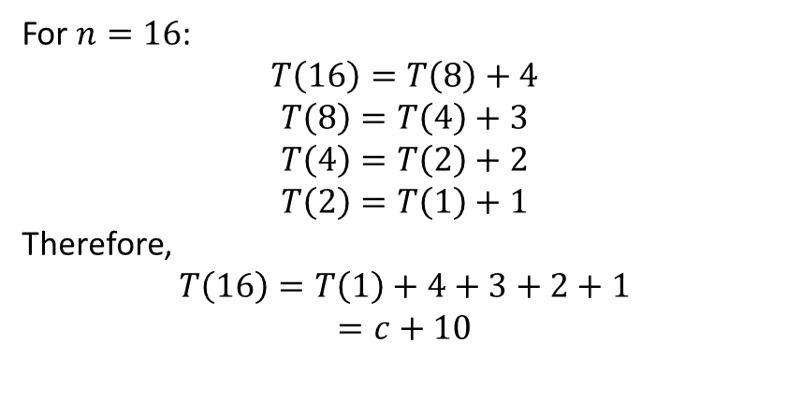
WORKING EXAMPLE (DRY RUN)
General Expansion:
For $n=16$:
$$T\left(16\right)=T\left(8\right)+4$$
$$T\left(8\right)=T\left(4\right)+3$$
$$T\left(4\right)=T\left(2\right)+2$$
$$T\left(2\right)=T\left(1\right)+1$$
Therefore,
$$T\left(16\right)=T\left(1\right)+4+3+2+1$$
$$=c+10$$
Step | Expression
1 | (T(n)=T(n/2)+\log n)
2 | (=T(n/4)+\log(n/2)+\log n)
3 | (=T(n/8)+\log(n/4)+\log(n/2)+\log n)
k | (=T(n/2^k)+\sum_{i=0}^{k-1}\log(n/2^i))

Slide 6

Complexity Analysis
Recursion stops when $n/2^{k}=1$.
Therefore, $k=\log{n}$.
Sum becomes:
$$\sum_{i=0}^{\log{n}−1}{(}\left.\log{n}−i\right)$$
This simplifies to:
$$\frac{\log{n}\left(\log{n}+1\right)}{2}$$
Final Time Complexity:
$$\boxed{T\left(n\right)=Θ\left({\left(\log{n}\right)}^{2}\right)}$$

Slide 7
COMPARATIVE ANALYSIS
METHOD | SUITABLE FOR | RESULT
Substitution Method | Pattern identification | Θ((log n)²)
Iteration Method | Stepwise expansion | Θ((log n)²)
Recursion Tree | Visualization | Θ((log n)²)
Master Theorem | Standard forms | Not directly applicable in basic form
Key Points
Substitution clearly reveals recursive behavior.
Easy to verify each mathematical step.
Provides intuition behind recurrence solving.
Produces the same complexity as iteration.

Slide 8
APPLICATIONS
Performance analysis of divide-and-conquer algorithms that repeatedly divide the input into smaller subproblems.
Recursive searching and hierarchical processing algorithms where input size decreases exponentially.
Complexity analysis of binary recursive procedures used in computer science and software engineering.
Evaluation of recursive mathematical algorithms that involve logarithmic computations at each stage.
Used in algorithm design courses to understand recurrence solving techniques and asymptotic analysis.

Slide 9
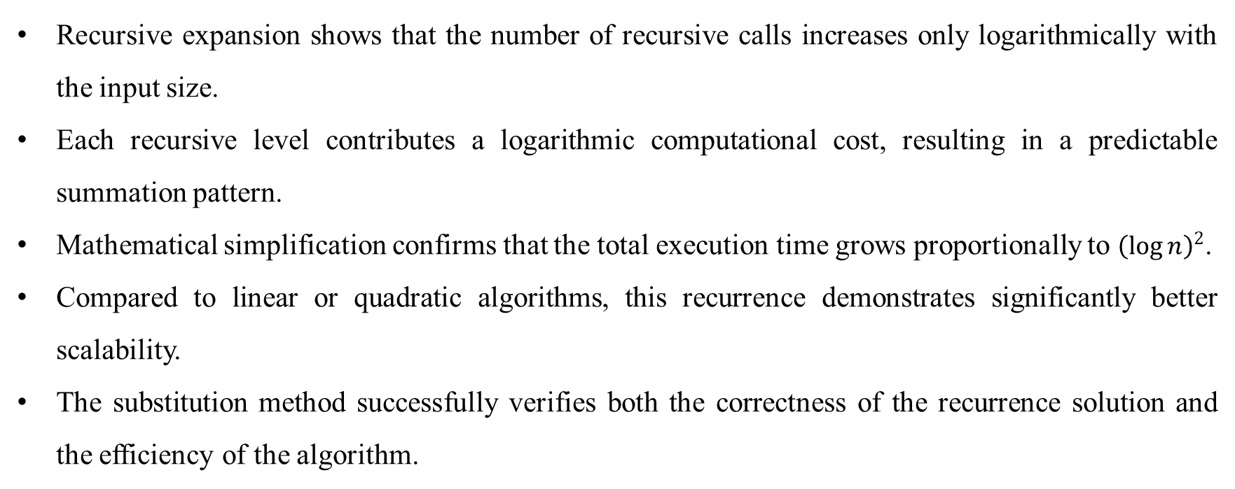
RESULTS & DISCUSSION
Recursive expansion shows that the number of recursive calls increases only logarithmically with the input size.
Each recursive level contributes a logarithmic computational cost, resulting in a predictable summation pattern.
Mathematical simplification confirms that the total execution time grows proportionally to ${\left(\log{n}\right)}^{2}$.
Compared to linear or quadratic algorithms, this recurrence demonstrates significantly better scalability.
The substitution method successfully verifies both the correctness of the recurrence solution and the efficiency of the algorithm.

Slide 10
CONCLUSION
The substitution method systematically expands the recurrence.
Mathematical simplification reveals the summation pattern.
Final time complexity is Θ((log n)²).
The method provides clear proof of algorithm efficiency.
Useful for analyzing divide-and-conquer recurrences.
REFERENCES
Thomas H. Cormen, Charles E. Leiserson, Ronald L. Rivest, Clifford Stein, Introduction to Algorithms, 4th Edition, MIT Press.
Ellis Horowitz, Sartaj Sahni, Sanguthevar Rajasekaran, Fundamentals of Computer Algorithms.
Alfred V. Aho, John E. Hopcroft, Jeffrey D. Ullman, The Design and Analysis of Computer Algorithms.
Donald E. Knuth, The Art of Computer Programming, Volume 1.

Slide 11
THANK YOU

